Slide 1
Math and Music Theory
Osha Fiuty

Slide 2
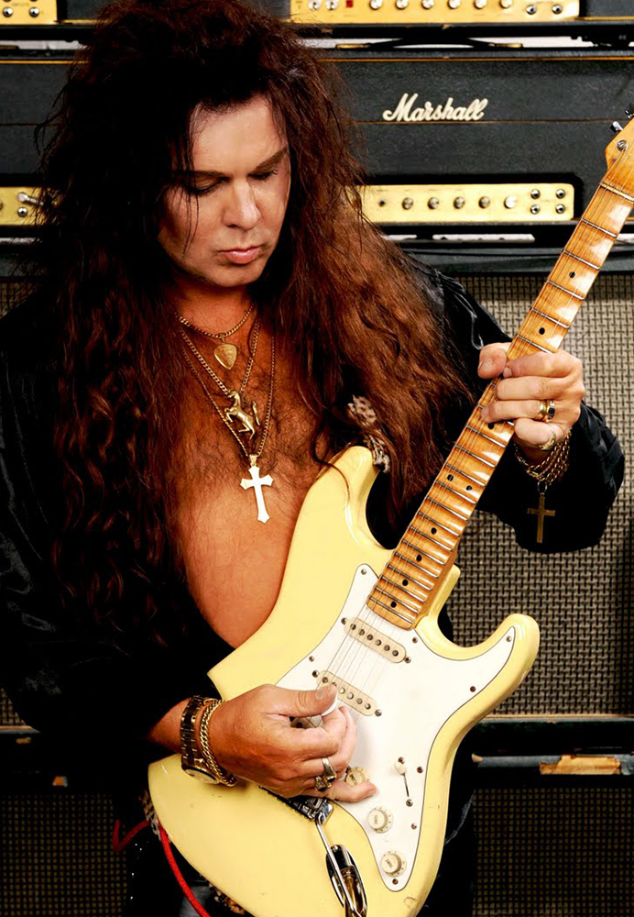
The Greek Modes
Modes are musical scales developed by the Greeks that work in a series of pitch relationships. These 7 note modes create melodic tones based on their intervals. This is where the math comes in, when you must determine intervals. Using extremely simple mathematic application, a musician can tell you the specific mode that is formed in this series of numbers 2122122.

Slide 3
This is possible through the use of the musical intervals of a whole step and a half step. A whole step (whole tone) is a two note change or two fret difference if you are talking about a guitar. A half step (semi tone) is a single note or fret change. So, if you know all of the intervals in a mode (they will only be whole steps or half steps), then by assigning a 1 to half steps and 2 to whole steps you can both read and write modes in a numerical method. In music you often hear people refer to things like major 7 or diminished 4th. These different numbers are assigned to the scale degrees in a mode. You have your root, your maj/min second, maj/min third, perfect fourth, perfect fifth, maj/min sixth, and maj/min seventh .The different notes in a mode can also have different relations to each other and it is all based on their numerical places that have been designated based on their tonal differences. The mode system would be far more confusing and impossible to fully grasp without the simple but useful application of numbers.

Slide 4
Different methods of writing out the intervals of a mode
2122122
Maj-Min-Maj-Maj-Min-Maj-Maj
W-H-W-W-H-W-W

Slide 5
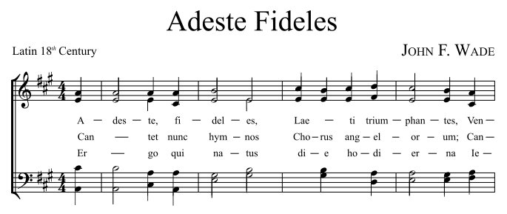
Math and Sheet Music
In music theory, there is a system of different note lengths. This system uses math to find the divisions of a beat, the length of a measure, and the right tempo to be playing at. You first have your different notes, whole note, half note, quarter note, eighth note, and sixteenth note. Each counts as a certain number of beats or certain amount of beat divisions.

Slide 6


The easy yet essential math in different notes
Whole Note
Sixteenth Note
A whole note lasts for 4 beats. This means a whole note cannot be played in a measure that is in ¾ time, or in any time signature less than 4/4.
A Sixteenth note lasts for one fourth of a beat. This does not mean you have to play four in a row whenever you use them, it just means that they only make up a small portion of a beat.

Slide 7
Works Cited
"Music Theory Lessons, Guitar Theory, Modal Theory, Bass Lessons." Modes And Modal Scales. TheoryLessons.com, 2010. Web. 13 Nov. 2014. <http://www.theorylessons.com/modes005themodes.php>.
I only used one source because much of the information I used I already knew.

