Slide 1
Mathematics in Music
(and audio engineering)
By Anthony Edwards

Slide 2
Mathematics in Music Theory
Time signatures
  Time signatures show how long each note lasts.
  They can be expressed mathematically, for example
    Assuming a 4/4 timescale, a single quarter note would last 1/4th of the measure since 4 x ¼ (quarter note) = 1.

Slide 3
Mathematics in Audio Engineering
Length of a sound wave
  You can find the exact length of a sound wave by doing this formula
    Wave Length = Speed of Sound / Frequency
    EX:
      331.3m/sec (air temperature of 20c) / 261.6Hz (Middle C) = a wave length of 4.155 feet

Slide 4
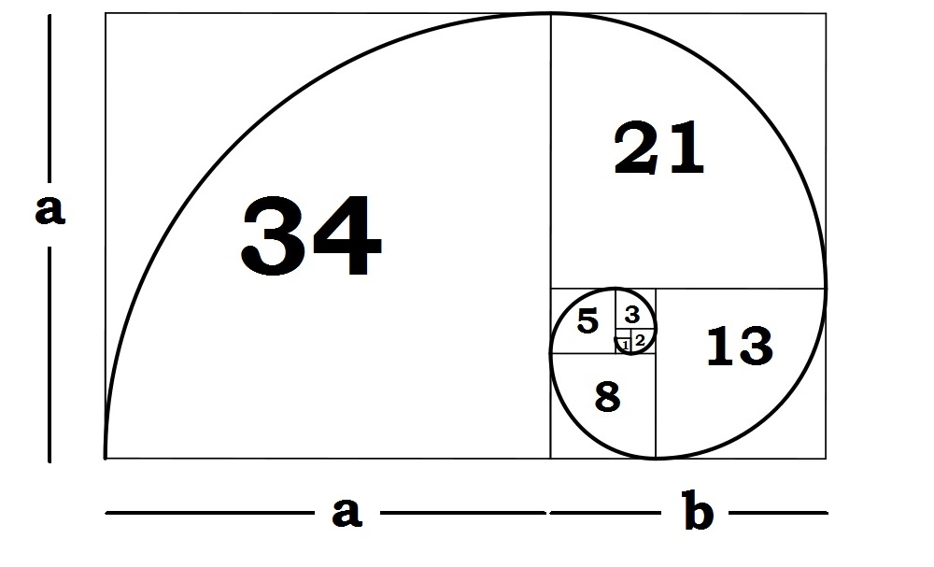
Golden Ratio in Music
The golden ratio is a special number found by dividing a line into two parts so that the longer part is divided by the small part is also equal to the whole length divided by the long part

Slide 5
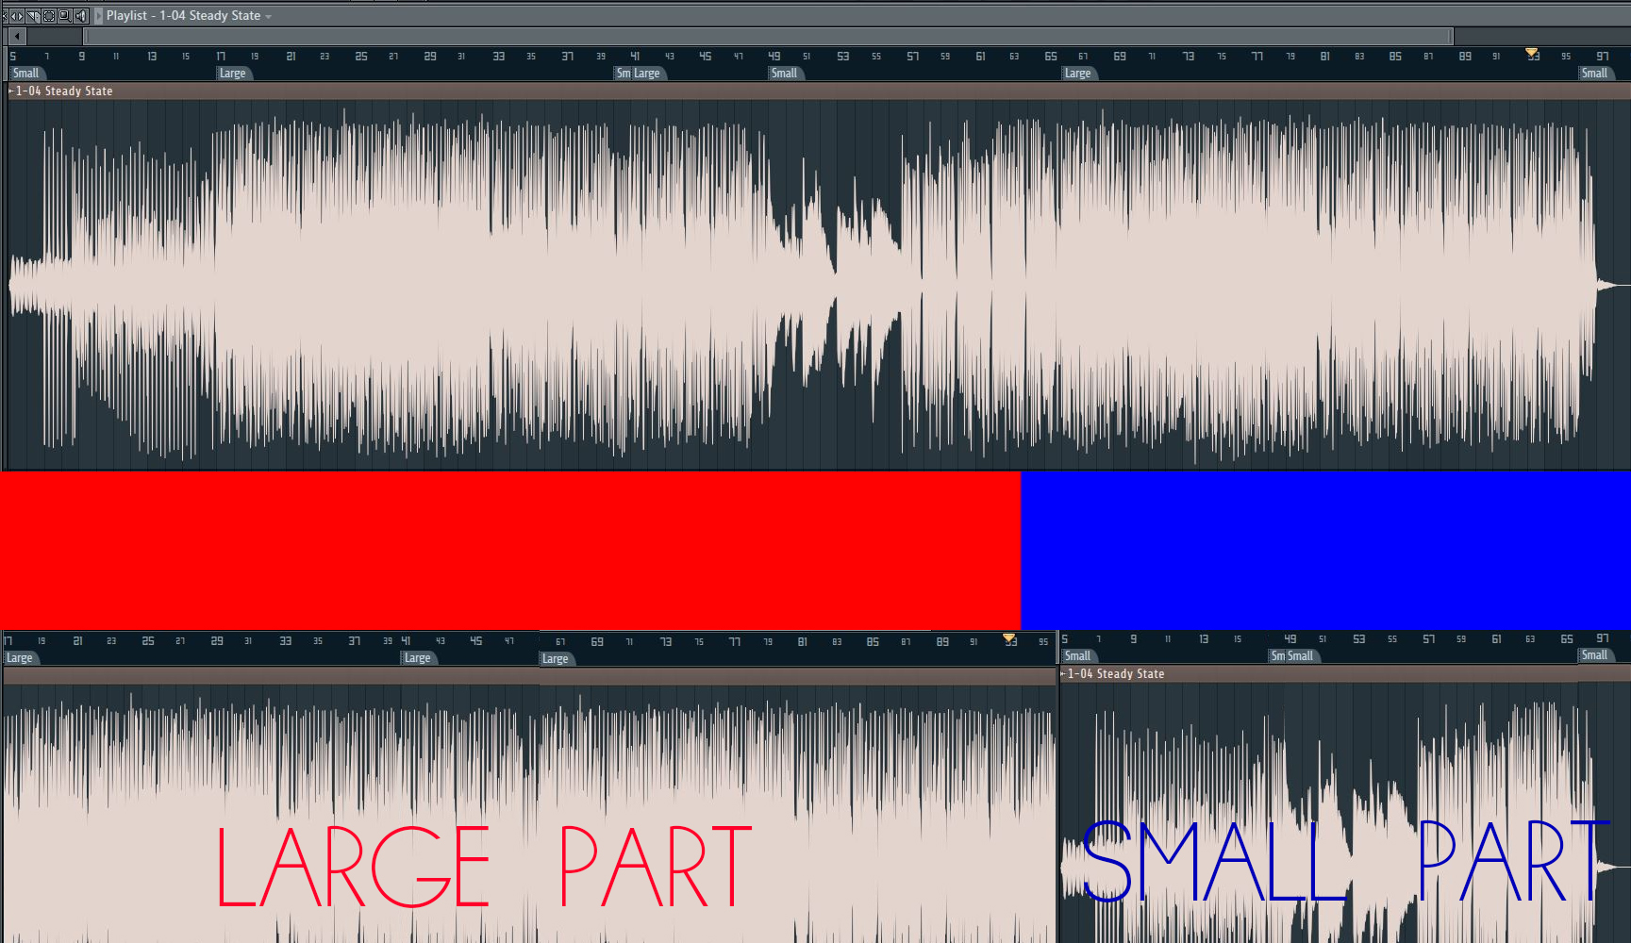
Golden Ratio in Music

Slide 6
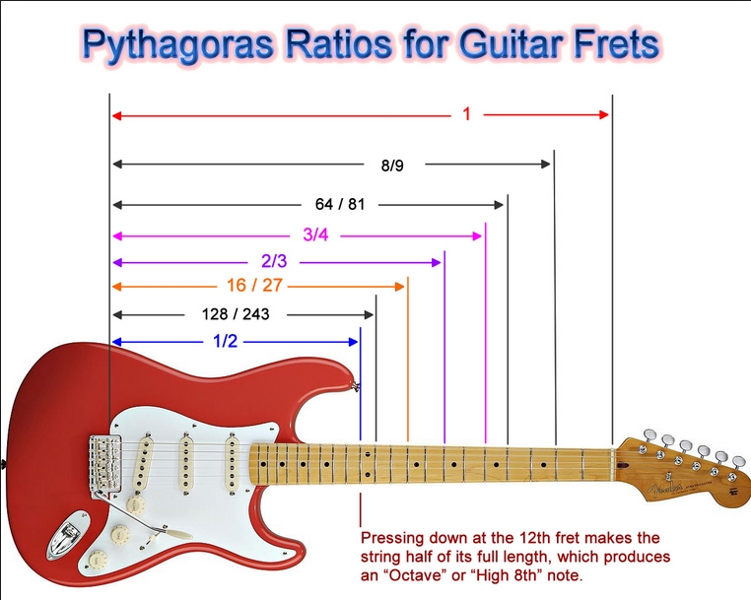
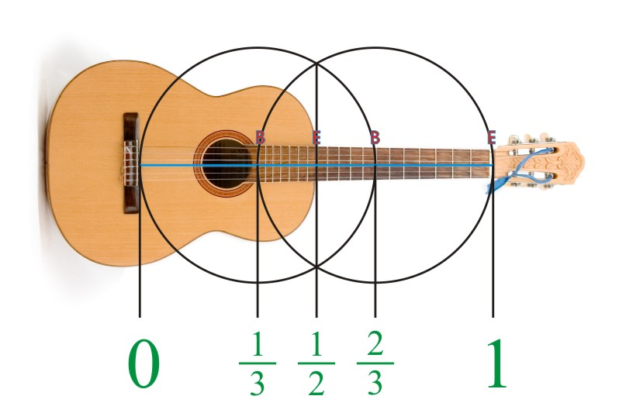
Some cool other stuff that I don’t completely understand

Slide 7
Sources
http://mathcentral.uregina.ca/beyond/articles/Music/music1.html
http://people.sju.edu/~rhall/newton/article.pdf
http://www.sengpielaudio.com/calculator-waves.htm

