Slide 1
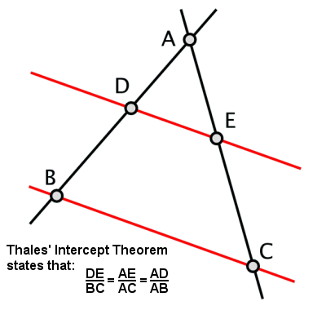
Thale’s intercept theorem

Slide 2
Thale’s Intercept Theorem
Thale’s intercept theorem states that if two intersecting lines are intercepted by a pair of parallel lines, then you may find the ratios of the various line segments created using this equation: A/B = C/D
This theorem was created by Thales of Miletus, a pre-Socratic (before Socrates) mathematician and philosopher.

Slide 3
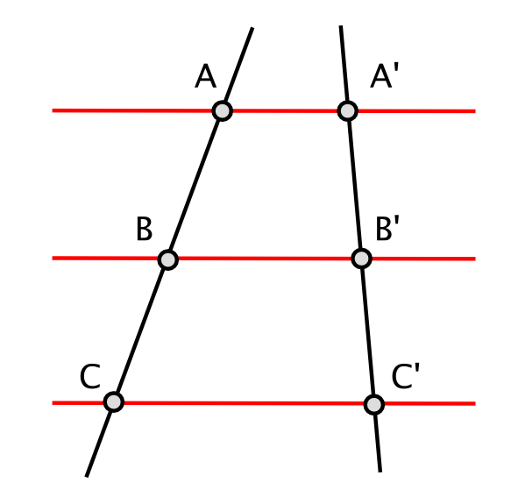
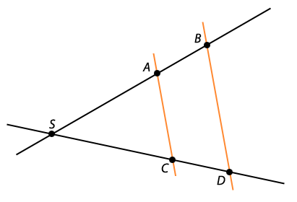
In different problems the intersections will be drawn differently. Sometimes, you will have the intersecting lines meet and make a point that you must include in your equation
Here, because point s is marked, you would write the equation like this: SA/AB = SC/CD
Here, you have no point created by the intersecting lines.

Slide 4
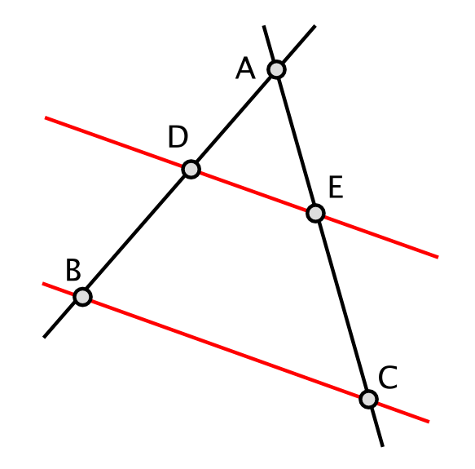
How do I use Thale’s theorem?
Let’s say here, we are given the values, AD=5, DB=6, and AE=5. You would then plug those numbers into the equation like so: 5/6 = 5/EC. Next, you cross multiply your numbers and end up with 5EC = 30. Then you divide 30 by 5 and you are left with your EC value of 6. These are the steps to using Thale’s intercept theorem.

