Slide 1
Triangle Types
By: Stormy Sgrillo, Dominique Arellanes, and Emmaleigh Rivera

Slide 2
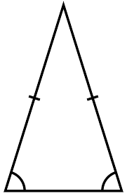
Isosceles Triangle
Triangle with two equal sides and two equal angles.

Slide 3
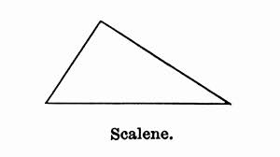
Scalene Triangle
Triangle with no equal sides or angles.

Slide 4
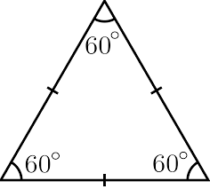
Equilateral Triangle
Triangle with three equal sides and three equal angles that always measure 60 degrees.

Slide 5
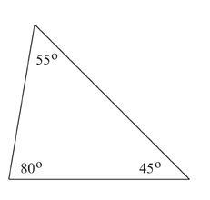
Acute Triangle
All angles are less than 90 degrees.

Slide 6
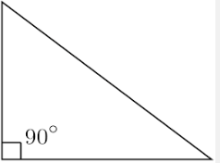
Right Triangle
A triangle in which one angle is a right angle.

Slide 7
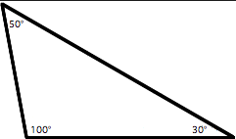
Obtuse Triangle
A triangle where an indicated angle is larger than 90 degrees but less than 180 degrees.

