Slide 1
Looking at graphs:
Types, Interpretation, and Meaning
This fine day November the 18th, 2014
One month left guys!

Slide 2
We’re going to learn about:
Purpose
Uses
Types
Examples
And throughout, we’ll look at graphs and
practice interpreting them

Slide 3
Purpose of Graphs:
Display, explain, understand quantifiable data
  “Quantifiable” means “measurable”
  “Data” implies information that has been purposefully collected

Slide 4
Graphs are used in:
Statistics*
Physics
Geology
Environmental Science
Biology
Mineralogy
Media*
Sociology

Slide 5
*…the only problem is…
…It’s really easy to lie to people with your graphs.
This is done by not having proper
Scaling
Labeling
Sizing
Descriptions
Color choice

Slide 6
Some types of graphs:
Linear
Bar graphs
Gantt charts
Scatter plot
Triangular plot
Quadratic
Sinusoidal

Slide 7
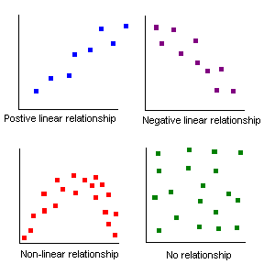
Linear Relationships:
Notes:
From http://www.comfsm.fm/~dleeling/statistics/relationships.gif

Slide 8
Data set meanings:
No correlation : no apparent meaning can be drawn
  No relationship
Positive Relationship: as one quantity increases, so does the other
  Possible relationship
Negative Relationship: as one quantity increases, the other does not
  Possible relationship

Slide 9
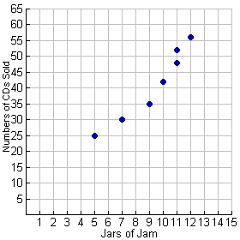
Is there necessarily a relationship?
Notes:
http://www.regentsprep.org/regents/math/algebra/AD4/scatter.htm

Slide 10

What are these examples of?

Slide 11


Slide 12
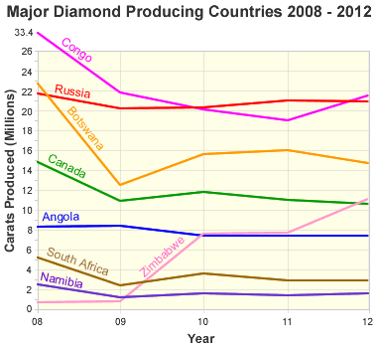
What is this graph saying?

Slide 13
Graph showing the production history of selected gem-quality diamond producing
countries. This graph shows how Canada began diamond production in 1998 and
quickly became one of the world's leading diamond producers. Values for 2012 are
estimated. Graph by Geology.com. Data from USGS Mineral Commodity Summaries.
Notes:
From http://geology.com/articles/canada-diamond-mines/

Slide 14
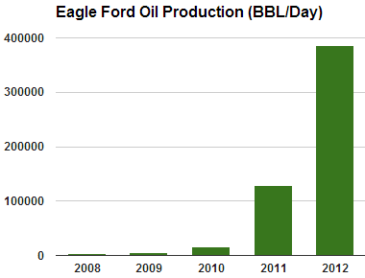
Bar Graph
Comparing different, but relatable, quantities to each other

Slide 15
This graph illustrates the average oil production from the Eagle Ford Shale in barrels per day. Prior to 2010 the production focus for the Eagle Ford was natural gas. Then, as the focus shifted to the more profitable oil portion of the play, the oil production rate exploded. Graph prepared using data from the Texas Railroad Commission.
Notes:
http://geology.com/articles/eagle-ford/

Slide 16
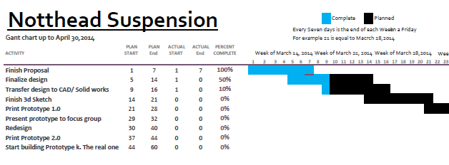
Gantt Charts
Showing ranges (timeline, progress, etc.)

Slide 17
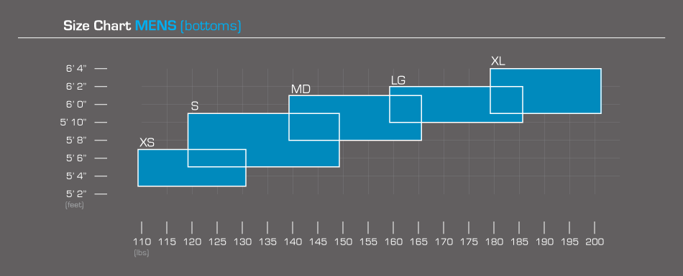
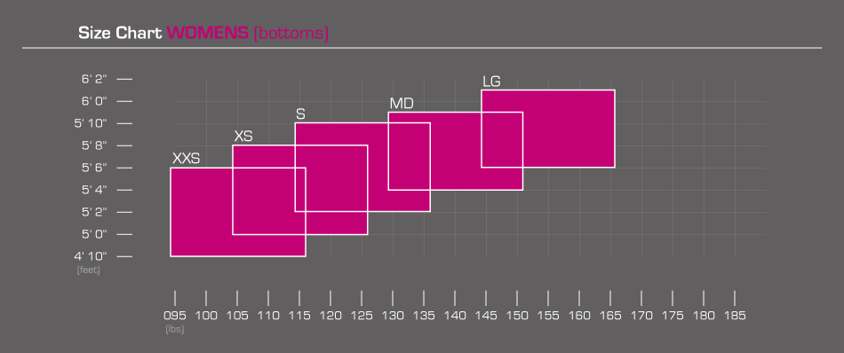
Notes:
Verve clothing company

Slide 18
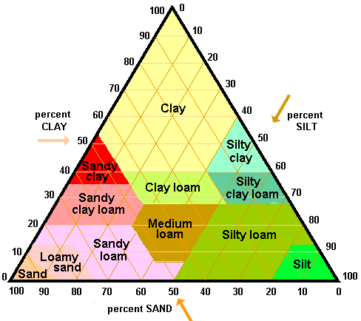
Triangular Plot
Notes:
A triangular plot graphs 3 different variables. It is often used to show the composition of soils and rocks in geology
http://perezmaps.blogspot.com/2011/03/triangular-plot.html

Slide 19
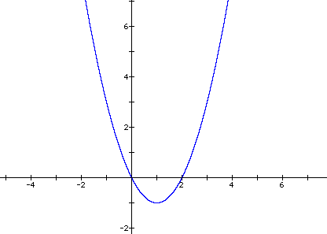
Quadratic Functions
Remember those kinematic equations, like
x = x₀ + v₀t + ½at²?

Slide 20
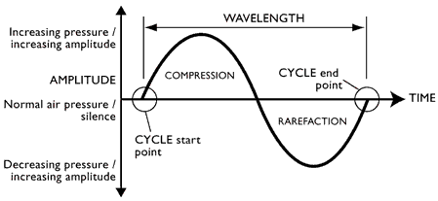
Sinusoidal Functions
Sound waves

Slide 21
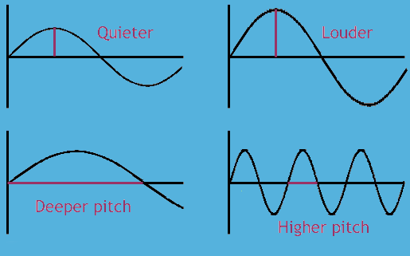

Slide 22
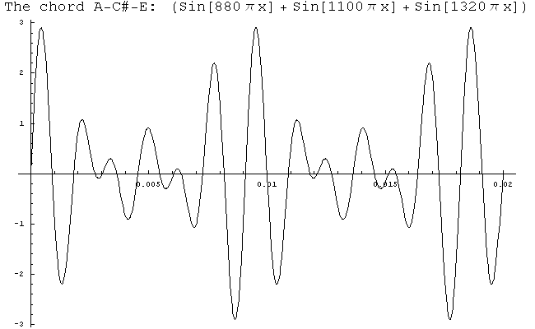

Slide 23
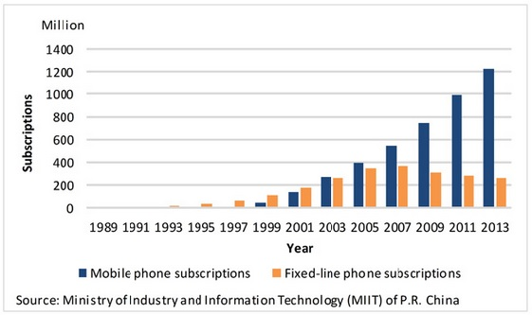
What do these graphs tell us?

Slide 24
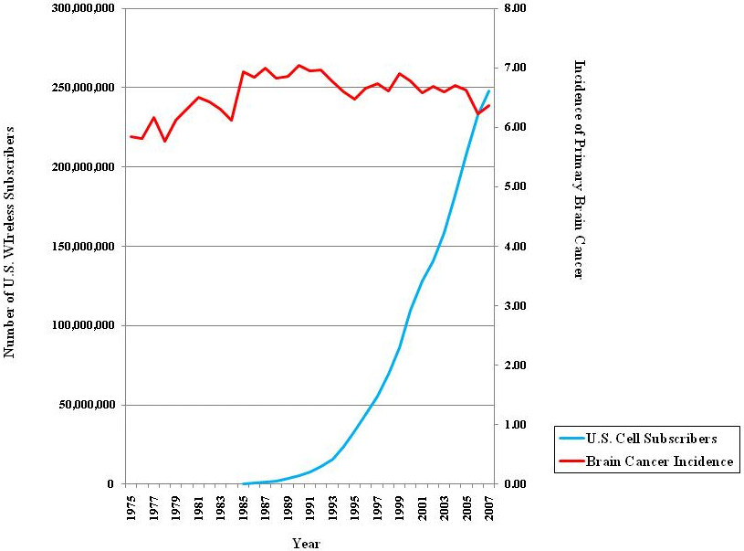
Notes:
Ask: what are some problems with this graph?

Slide 25
